Slide 1
Ch 3: Markov Chain & Queueing Theory
This lecture is partially based on that from Prof. Yannis A. Korilis

Slide 2
Topics
Markov Chains
Discrete-Time Markov Chains
Calculating Stationary Distribution
Global Balance Equations
Detailed Balance Equations
Birth-Death Chain

Slide 3
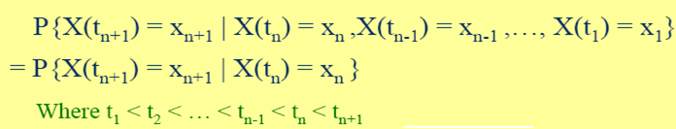
Markov Process: definition
A stochastic process {X(t), t ∈ T} is a Markov Process if it satisfies the Markov (Memoryless) Property
The value that X(t) takes is called the state of the system;
X(t1) = x1 means, the system is in state x1 at time t1;
Remarks on Markov Property : Given the present state, future state jumps of the chain are independent of past history
The past history is summarized in the current state
future state, current state, past states

Slide 4
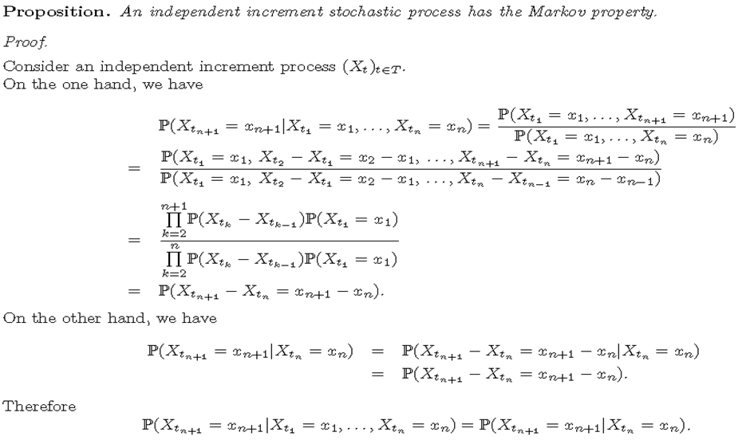
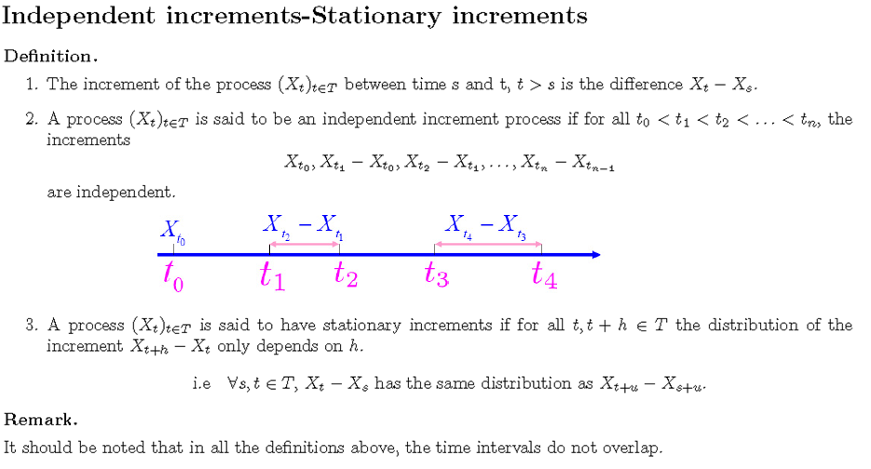
Markov Property & Independent increment
Notes:
Let {X(t), t≥0} be an independent increment process (i.i.p.), where X(0)=0. Prove that {X(t), t≥0} is a Markov process (m.p.).
Prove:
According to the definition of m.p., we need to prove that given X(t_{n-1})=x_{n-1}, X(t_n) is independent of X(t_j), j=1, 2, …, n-2.
From the definition of i.i.p., for 0<t_j<t_{n-1}<t_n, j=1, 2, …, n-2, X(t_j)-X(0) is independent of X(t_n)-X(t_{n-1}).
From the conditions, X(0)=0 and X(t_{n-1})=x_{n-1}, we have X(t_j) is independent of X(t_n)-x_{n-1}. Note that X(t_{n-1}) is a r.v. while x_{n-1} is a deterministic value of X(t_{n-1}).
On the other hand, we have one theorem that if U is independent of V, then the function of U is independent of the function of V, where U and V are r.v., respectively. Therefore, applying this theorem, we have that X(t_j) is independent of X(t_n) from that X(t_j) is independent of X(t_n)-x_{n-1}, under the conditions of X(0)=0 and X(t_{n-1})=x_{n-1}.
Then, we conclude that, P(X(t_n)=x_n| X(t_{n-1})=x_{n-1}, X(t_{n-2})=x_{n-2},…, X(t_{1})=x_{1})= P(X(t_n)=x_n|X(t_{n-1})=x_{n-1})

Slide 5
Markov Chain: definition & terminologies
Markov Chain: a Markov process {X(t), t ∈ T}, whose states takes values on a discrete (finite or countable) state-space.
Time-homogeneous Markov Chain if transition probabilities are independent of tn (or rely on tn+1-tn only),
≡ P[X(tn+1) = j | X(tn)= i]
Discrete Time Markov Chain (DTMC):
State (discrete state) changes occur at integer points
Continuous Time Markov Chain (CTMC):
State (discrete state) changes occur at an arbitrary time
In this course, we only consider time-homogeneous discrete-time Markov Chain.
Notes:
arbitrary /ˈɑːbɪtrəri/

Slide 6
DTMC: Notations
Markov Chain {X_{n} : n = 0,1,2,… }
Discrete state space
{X_{n} =0,1,2,…} for infinite states
{X_{n} =0,1,2,…, M} for finite states
Memoryless property:
Pij = one-step transition prob.
= prob. that the system is in state i
and it will next be in state j
(Memoryless property)
(Homogeneous property)

Slide 7
One-step transition probability & Matrix
One-step transition prob., Pij,
One-step transition matrix, P

Slide 8
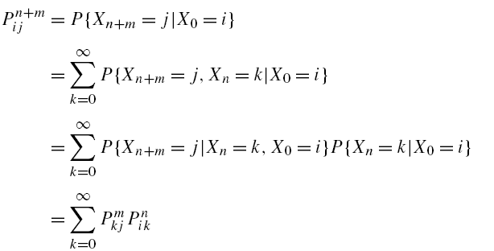
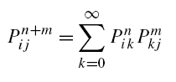
n-step transition probability
n-hop transition prob.,
Chapman–Kolmogorov equations (C.K. equation)
Law of total probability
Notes:
The event E∪F is called the union of the event E and the event F
The event E∩F is called the intersection of the event E and the event F
E is contained in F and we write E⊂F
E and F are said to be mutually exclusive if E∩F=∅
Commutative laws: E∪F = F∪E
Associative laws: (E∪F)∪G=E∪(F∪G)
Distributive laws: (E∪F)∩G=(E∩G)∪(F∩G)
commutative [kə'mju:tətiv]
associative [ə'səuʃjətiv]
distributive [dis'tribjutiv]
equality [i:'kwɔləti], n. 平等；相等；[数] 等式

Slide 9
n-step transition probability

Slide 10
n-step transition matrix
The matrix form of C.K. equaiton
n-step transition matrix
Recursive relationship
Notes:
square brackets: []
angle brackets: <>
round brackets: ()
curly brackets: {}

Slide 11
Transient probability (time-dependent)
Transient probability
In the matrix form: let , we have
Recursive relationship
Conclusion: given and , we can find
Notes:
transient ['trænziənt, -si-, -ʃənt, 'trɑ:n-]

Slide 12
Example: weather model
Weather:
raining today 70% rain tomorrow
30% no rain tomorrow
not raining today 40% rain tomorrow
60% no rain tomorrow
Stochastic FSM (finite state machine):
0.7
0.3
0.6
rain
no rain
0.4

Slide 13
Example: weather model
Weather:
raining today 70% rain tomorrow
30% no rain tomorrow
not raining today 40% rain tomorrow
60% no rain tomorrow
One-step transition matrix:
Stochastic matrix:
Rows sum up to 1
Double stochastic matrix:
Rows and columns sum up to 1
Notes:
stochastic [stɔ'kæstik, stəu-]

Slide 14
Example: weather model
Question: given P, how about ?

Slide 15
Example: weather model

Slide 16
Stationary Distribution
In matrix form:
If time-dependent distribution converges to a limit
π is called the stationary distribution, which satisfies
Existence depends on the structure of Markov chain

Slide 17
Irreducible or Aperiodic Markov Chains
Irreducible:
States i and j communicate:
Irreducible Markov chain: all states communicate
Aperiodic:
State i is periodic:
Aperiodic Markov chain: none of the states is periodic
1
2
1
2
0
0
3
4
3
4
Counterexample:
stat 2 cannot arrive to stat 1.
Counterexample: For stat 0, d=3.
Any return to 0 in 3 steps, e.g,
0-2-4-0, 0-2-3-0, …
Notes:
aperiodic [ˌeipiəriˈɔdik]
irreducible /ˌɪrɪˈdjuːsəbl/
Note A: in the figure in irreducible states:
The M.C. state is irreducible if there is only one class.
Note B: in the figures in aperiodic states:
The period of each state = 3; All states can be classified into three types:
State {0 }: in-degree num = 2; out-degree num = 2;
State {1, 2}: in-degree num = 1; out-degree num = 2;
State {3, 4}: in-degree num = 2; out-degree num = 1;
According to the definition of the aperiodic, if the state i will jump to itself in one-step,
say, in pp. 10, the state “rain” will jump to itself with probability 0.7,
then the state i must be aperiodic.

Slide 18
Existence & Uniqueness of Stationary Distribution
Theorem: If a Markov chain is
(a) irreducible,
(b) aperiodic,
(c) homogeneous, and
(d) has finite states,
then the stationary distribution of the Markov chain
must exist and be unique.
In the practical application, we are most interested in the stationary distribution, rather than the transient distribution.
Notes:
transient /ˈtrænziənt/

Slide 19
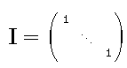
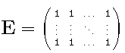
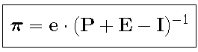
Calculation of Stationary Distribution
Finite number of states
Method 1: Solve explicitly the system of equations
(all-ones vector)
Alternatively
(unit matrix)
π⋅P = π ⇒ π⋅(P-I) = 0
π⋅e^{T} = 1 ⇒ π⋅E = e
⇒
π⋅(P+E-I) = e
(write n copies)
Solving equation
Matrix solution
Method 2: calculate since P^{n} will converge to a matrix with each row equal to π
Suitable for a small number of states
Method 2: calculate since P^{n} will converge to a matrix with each row equal to π
Suitable for a small number of states
Notes:
recurrence formula
【计】 迭代公式
A^(−1): the inverse of A.

Slide 20
Example: Weather example
Use method 1 to calculate the stationary distribution of the weather example.
Solving equation: solve manually the system of linear equations
Matrix solution: solve it by using Matlab to calculate the inverse matrix
Use method 2 to calculate the stationary distribution of the weather example.
Method: solve it by using Matlab to calculate the inverse matrix

Slide 21
Example: Two-state machine
Consider a machine that can be either up or down. If it is up on day n, it is down on day n+1 with probability a (0≤a≤1), independent of the past. If it is down on day n, it is up on day n+1 with probability b (0≤ b ≤1), also independent often past. Let Xn be the state of the machine (0 if it is up, and 1 if it is down).
Plot the state transition diagram.
Write the one-step and n-step state transition Matrix.
Calculate the stationary distribution of Xn using two methods.
Solution

Slide 22
Example: Gambler’s Ruin
Consider two gamblers, A and B, who have a combined fortune of n dollars. They bet one dollar each on the toss of a coin.
If the coin turns up heads, A wins a dollar from B.
If the coin turns up tails, B wins a dollar from A.
Suppose the successive coin tosses are independent, and the coin
turns up heads with probability p and tails with probability q=1-p.
The game ends when either A or B is broken (or ruined).
Let Xk denote the fortune of gambler A after the k-th toss.
Plot the state transition diagram.
Calculate the stationary distribution of Xk
Solution
Notes:
ruin /ˈruːɪn/ 毁灭
gambler [ˈgæmblə] 赌徒

Slide 23
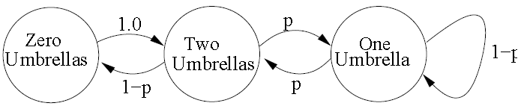
Example: Absent-minded professor problem
Absent-minded professor uses two umbrellas when commuting between home and office. If it rains and an umbrella is available at her location, she takes it. If it does not rain, she always forgets to take an umbrella. Let p be the probability of rain each time she commutes. What is the probability that she gets wet on any given day?
Markov chain formulation
i is the number of umbrellas available at her current location
Transition matrix
State = the number of umbrellas available at her current
location (i.e., either at home or at office)
Notes:
commute /kəˈmjuːt/

Slide 24
Solution: Method 1
0
2
1

Slide 25
Solution: Method 2
Taking p = 0.1:
Numerically determine limit of P^{n}

Slide 26
Calculation of Stationary Distribution
Infinite number of states
Cannot apply previous methods to problem of infinite dimension
Guess a solution to recurrence:
Notes:
recurrence formula
【计】 迭代公式

Slide 27
Global Balance Equations—Form 1
Form 1:
is the frequency of transitions from j to i. Form 1 states that when the system is in the steady state, we have
0
1
2
n
n+1

Slide 28
Global Balance Equations—Form 2
S
Form 2:
is the frequency of transitions from j to i. Form 2 states that when the system is in the steady state, we have
0
1
2
n
n+1

Slide 29
Birth-Death Chain & detailed balanced equations
S
S^{c}
0
1
2
n
n+1
Definition: one-dimensional Markov chain with transitions only between neighboring states. That is,
P_{ij}=0, if |i-j|>1
For birth-death chain, GBE becomes DBE (detailed balanced equation)
Proof: Use GBE From 2. Let S ={0,1,…,n}, we have

Slide 30
Example: random walk
Problem: Consider a particle that moves randomly on a semi-infinite one-dimensional lattice where the lattice points are labeled, 0, 1, 2,…. The particle moves with the following transition probabilities:
Let Xn be the position of the particle (the label of the site) at time n. Thus {Xn, n≥0} is a DTMC on state-space S={0,1,2,…}.
Plot the state-transition diagram
Solve the stationary distribution

Slide 31
Solution: DBE
Solution: (1) the state-transition diagram is as follow.
0
1
2
i
i+1

Slide 32
Application: Geom/Geom/1/∞
Problem: Consider a queue at a bank. In every time slot,
a customer arrives with probability p
the HoL (head of line) customer leaves with probability q
Let Xn denote the queue length (or # of customers in queue).
Plot the state-transition diagram
Solve the stationary distribution
Solve the mean customer number and mean sojourn time per customer.

Slide 33
Solution: state-transition diagram
In a time-slot, one arrival with probability p or zero arrivals with probability 1-p
In a time-slot, the customer in service departs with probability q or stays with probability 1-q
Independent arrivals and service times
State: number of customers in system
Plot the state-transition diagram
0
1
2
n
n+1

Slide 34
Solution: stationary distribution
0
1
2
n
n+1

Slide 35
Solution: stationary distribution
The normalizing equation yield:
Noting that
we calculate the stationary distribution:
Note: the existence of the stationary distribution requires ρ<1

Slide 36
Solution: mean custom number & mean sojourn time

Slide 37
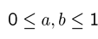
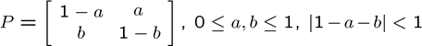
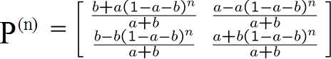
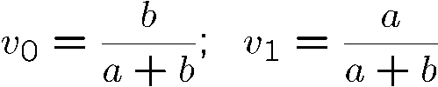
Solution: Two-state machine
State transition Diagram
N-step transition Matrix
Case 1: |1-a-b|=1. P=P^{(n)}=I for a+b=0; otherwise, …
Case 2: |1-a-b|<1.
Stationary solution
Case 1: |1-a-b|=1.
[ν0, ν1]=[1,0] or [0,1] for a+b=0
[ν0, ν1]=[1/2,1/2] for a+b=2
Case 2: |1-a-b|<1.
(by induction)
Return
Notes:
Solution: Modeling and Analysis of stochastic system (2nd), by Vidyadhar G. Kulkarni. (pp.15)
or ch7(two-state).ppt (pp.14)

Slide 38
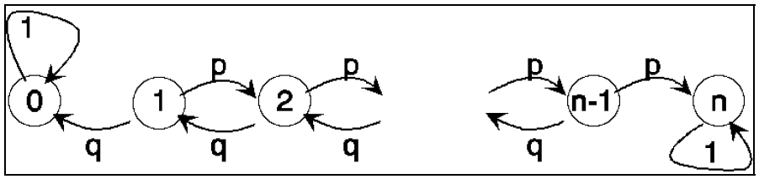

Solution: Gambler’s Ruin
State-transition diagram
Stationary solution
{Xk, k≥0} is a simple random walk on {0,1,2,…, n} with absorbing barriers at o and n.
Return
Notes:
Solution: Ref.: Modeling and Analysis of stochastic system (2nd), by Vidyadhar G. Kulkarni. (pp.17)
or Gambler's ruin (figure).ppt

Slide 39
Test 1 time
Date | Time | Group members | Paper title
10th week (April 9) | 20:30-21:15 | 徐方鑫 李嘉豪 | infocom12(BianchiModel)-AP Association in 802.11n WLANs with Heterogeneous Clients
11th week (April 16) | 20:30-21:15 | 辛宇晨 刘铭 | First choice: CarSpeak: A Content-Centric Network for Autonomous Driving Second choice: TUBE: Time-Dependent Pricing for Mobile Data.
12th week (April 23) | 20:30-21:15 | 周宇风 李楚光 | sigcom12-Flashback_Decoupled Lightweight Wireless Control

